Slide 1


Slide 2
Project
PRESENTATION

Slide 3

Research Submission and Evaluation System for University

Slide 4
Group Members Introduction
Ayesha Arbi (BC210409630)

Slide 5

INTRODUCTION OF PROJECT
The Research Submission and Evaluation System is a web-based platform designed for universities to streamline the process of submitting, evaluating, and publishing student research papers. It enables students to upload their research work, allows faculty members to evaluate and provide feedback, and helps administrators oversee the entire process efficiently.
The system fosters a transparent academic environment by replacing traditional manual methods with digital workflows

Slide 6
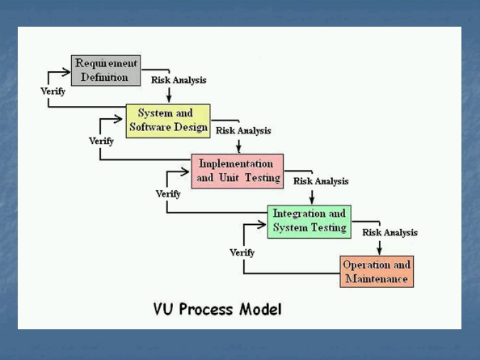
VU Process Model

Slide 7
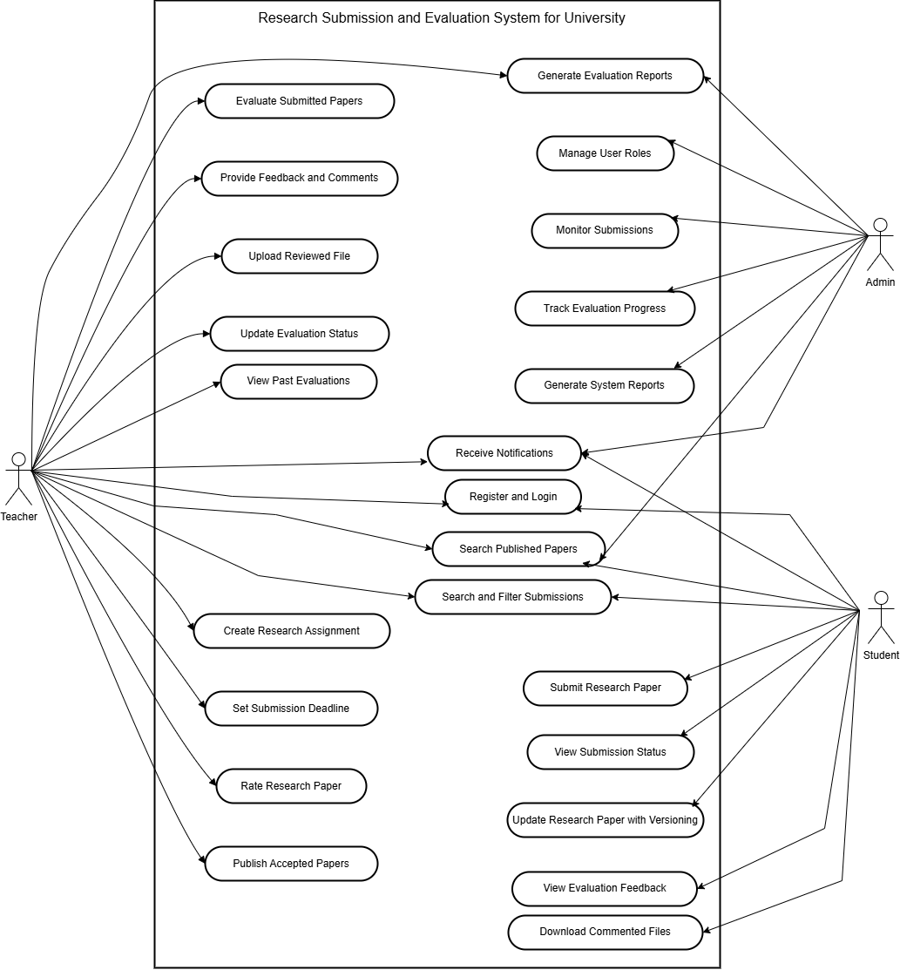
Use Case Diagram

Slide 8
Functional Requirements
User Registration: Students and faculty register with required details.
Role-Based Access: Students submit/view papers; faculty create/evaluate assignments; admin manages users and reports.
Paper Submission: Students upload PDF/Word papers with metadata before deadlines.
Evaluation: Faculty review papers, give ratings/feedback, upload commented files, and publish accepted work.
Versioning: Students can update papers with all versions logged.
Notifications: Email alerts for submissions, evaluations, feedback, and pending tasks.
Search & Filter: Find published papers by ID, program, category, date, or author.
Reports: Admin and faculty generate submission and evaluation reports.
Admin Panel: Manage users, track submissions, ensure timely evaluations.
Responsive Design: Works smoothly on desktop, tablet, and mobile.

Slide 9
Architectural Design

Slide 10
Team Structure
Supervisor:
Muhammad Saeed Amjad
Student:
Ayesha Arbi

Slide 11
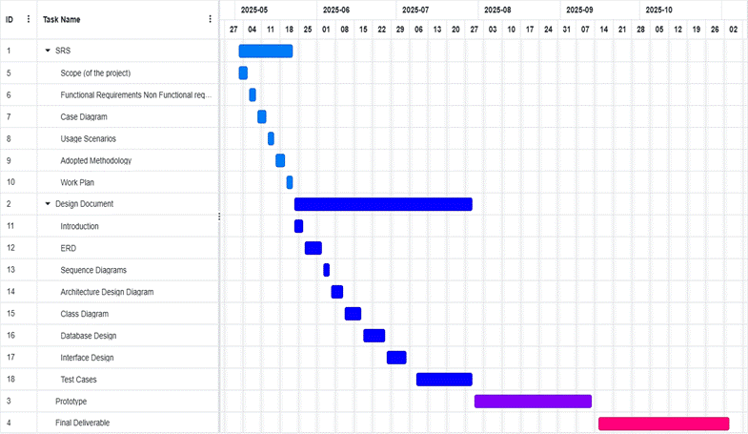
Project Schedule

Slide 12
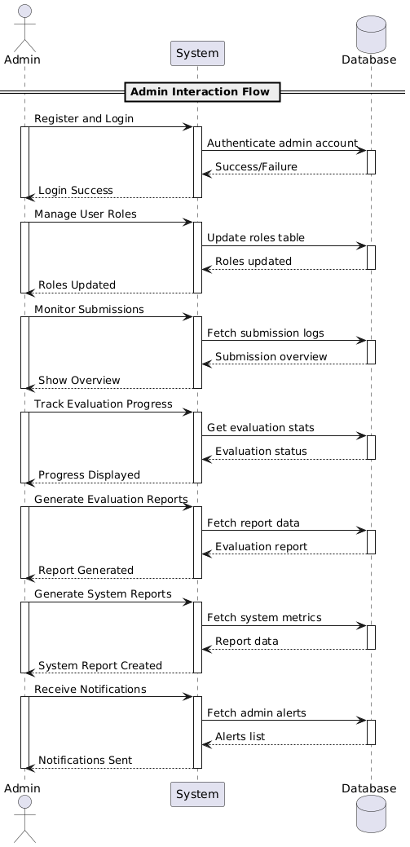
Sequence Diagrams
Admin:
.

Slide 13
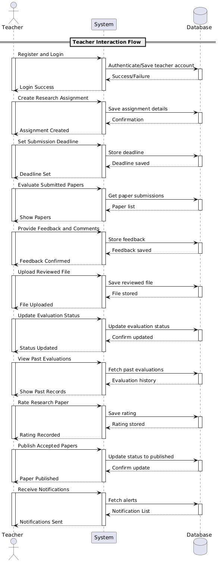
Sequence Diagrams
.

Slide 14
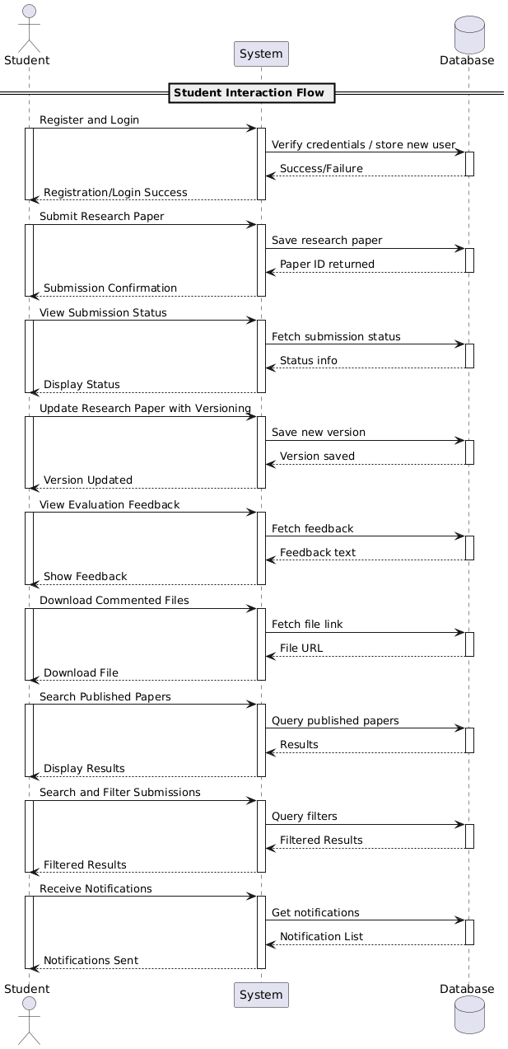
Sequence Diagrams
.

Slide 15
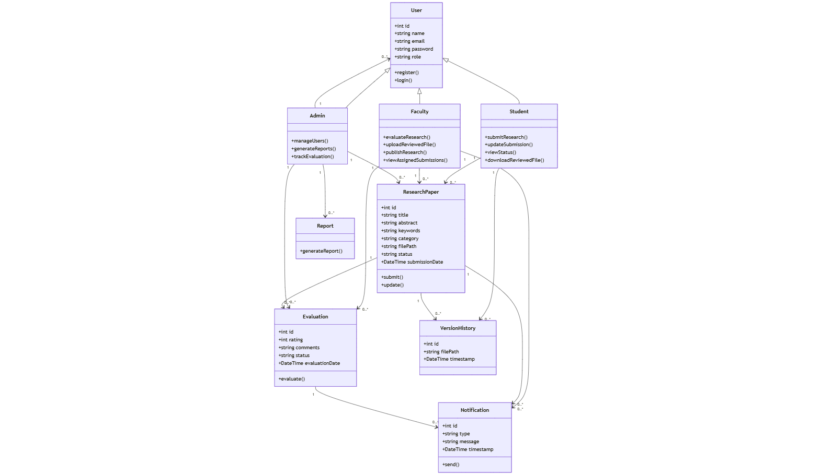
Class Diagram

Slide 16
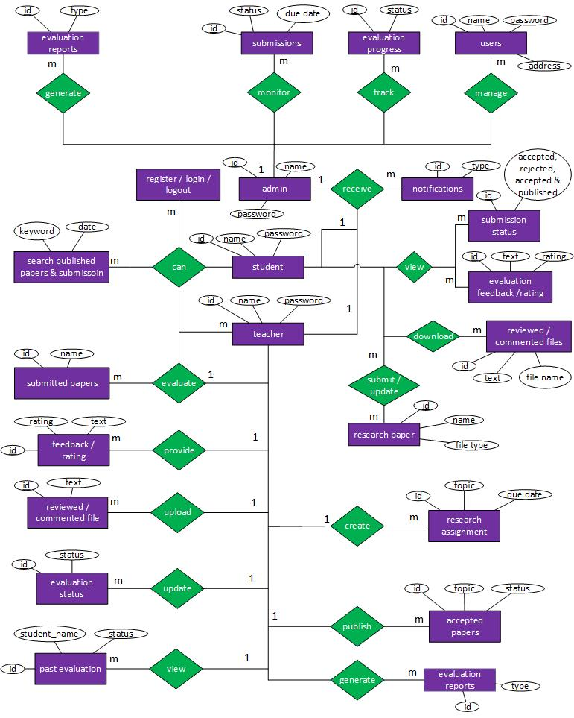
ERD

Slide 17
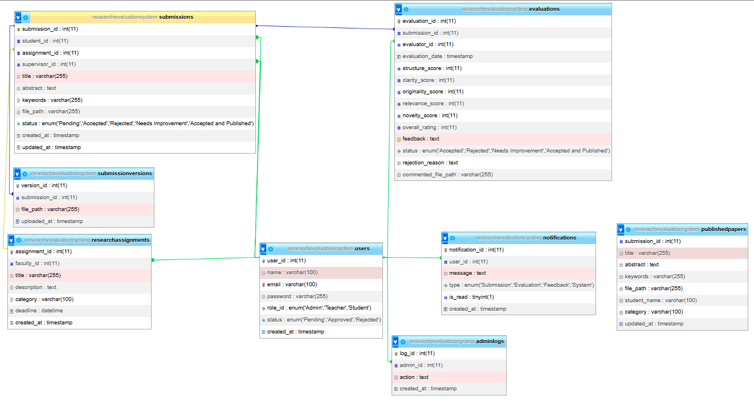
Database Diagram

Slide 18
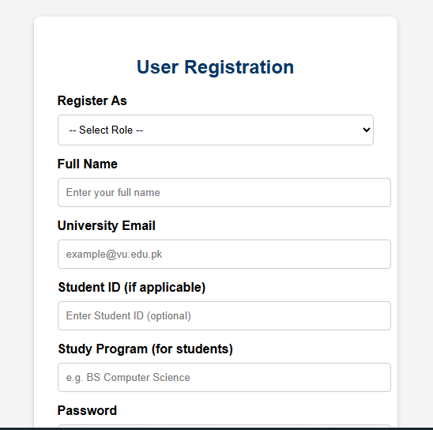
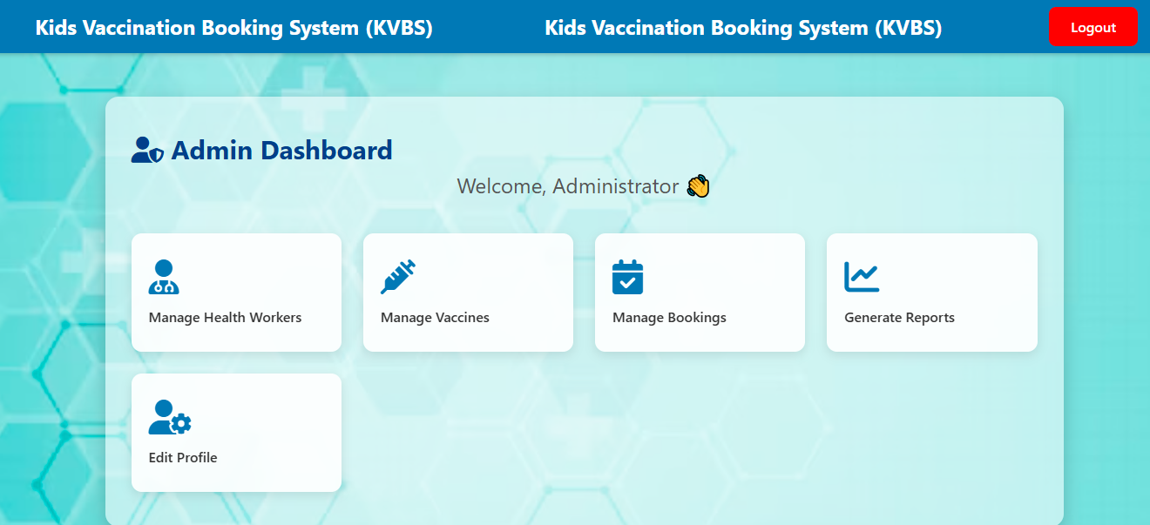
User Interfaces

Slide 19
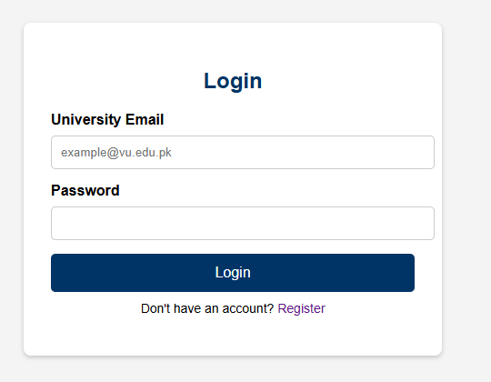
User Interfaces

Slide 20
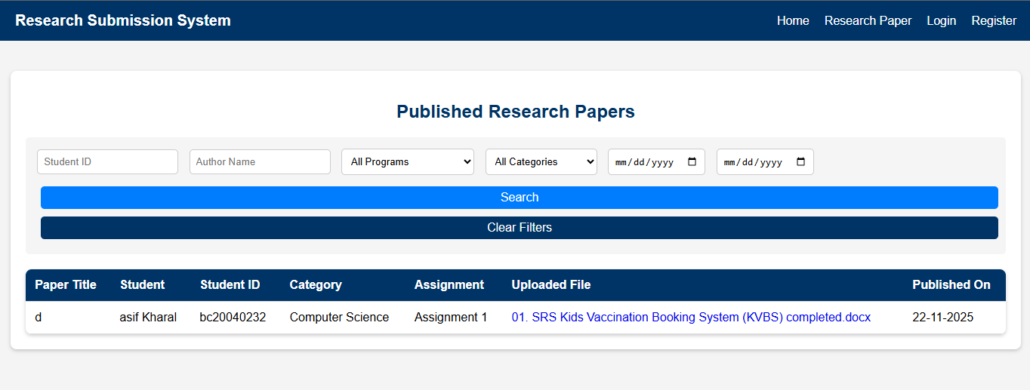
User Interfaces

Slide 21
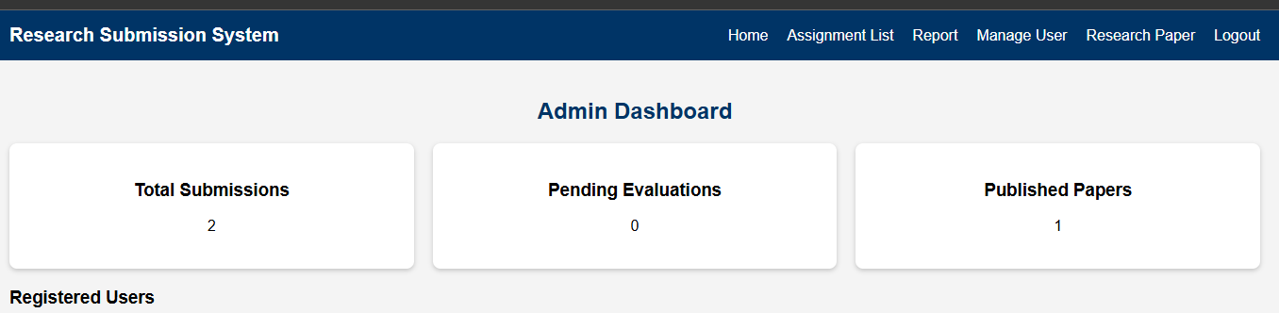
User Interfaces

Slide 22
Tools
Languages: HTML, CSS, PHP
Database Tool: MySql
Other Tools: Microsoft Office (Word, Visio, PowerPoint, MS Project) + VS Code

Slide 23
THANKS

